Slide 1
MEETUP BANNER GOES HERE
Replace this placeholder with the event banner (16:9) before each meetup

Slide 2
Sponsors & Partners
SPONSORS
PARTNERS
SPONSOR
SPONSOR
SPONSOR
PARTNER
PARTNER
logo goes here
logo goes here
logo goes here
logo goes here
logo goes here
Name · kind
Name · kind
Name · kind
Name · kind
Name · kind
A huge thank you to our sponsors and partners for making this meetup possible!
synvert xgeeks, a GlobalLogic company
2 / 10

Slide 3
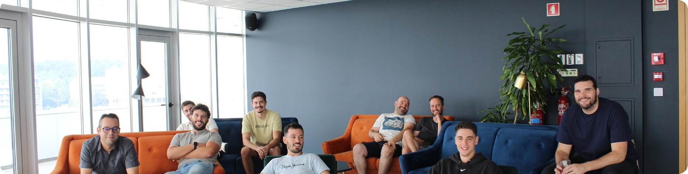

$ whoami
About xgeeks
100+
3
Top 50
9.1
synvert xgeeks is a team of engineers who accelerate enterprise success with AI-native and Cloud Native engineering — turning DevOps, data and AI into real business impact for the world's leading brands.
People
Locations
Teamlyzer
Employee NPS
synvert xgeeks, a GlobalLogic company
3 / 10

Slide 4


WE'RE
PART OF
synvert xgeeks, a GlobalLogic company
4 / 10

Slide 5

Accelerating enterprise success with AI and Cloud Native
Real business impact — powered by AI-native engineering, backed by GlobalLogic’s global scale.
A GlobalLogic Company
synvert xgeeks, a GlobalLogic company
5 / 10

Slide 6

$ kubectl apply -f ./expertise.yaml
AI-native engineering, end to end
Cloud Native Applications
Platform Engineering
AI Engineering
Data Engineering
synvert xgeeks, a GlobalLogic company
6 / 10

Slide 7

















$ kubectl apply -f ./clients.yaml
synvert xgeeks, a GlobalLogic company
7 / 10

Slide 8
What About [Community Name]
• [XXX] members on Meetup 👥
• [XX]+ members on Slack 💻
Community screenshot / photo goes here
• [X] meetups so far 📆
e.g. the Meetup.com group page
• 1 meetup per [cadence]
• [XXX]+ attendees (avg [XX] per meetup) 🎟️
synvert xgeeks, a GlobalLogic company
8 / 10

Slide 9

Tech Talks Formats
Porto Tech Talks logo goes here
[Short description of Viseu Tech Talks — cadence, focus, audience]
[Short description of Porto Tech Talks — cadence, focus, audience]
synvert xgeeks, a GlobalLogic company
9 / 10

Slide 10








$ kubectl apply -f ./community.yaml
synvert xgeeks acts as a driving force in tech ecosystems, growing and connecting communities.
Viseu Tech Talks
Leiria Tech Talks
Lisbon GenAI Community
AWS User Group Porto
Cloud Native Lisbon
Cloud Native Porto
DevOps Braga
LeadDev Meetup — Lisbon
DevOps Lisbon
synvert xgeeks, a GlobalLogic company
10 / 10

